Slide 1
Cyber Security model 1 AES-128 & RSA & SHA-256
Name: Mohamed Ahmed Helmy
ID: 201811769
Name: Marco Rimon Kamel
ID: 201804547

Slide 2
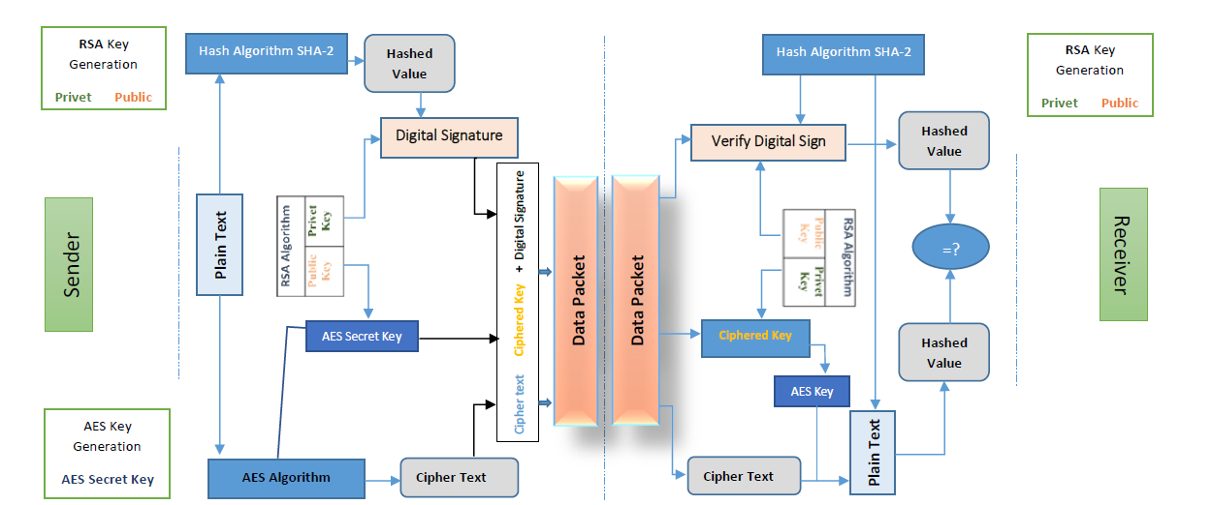

Slide 3
Code

